Slide 1
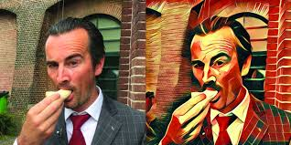

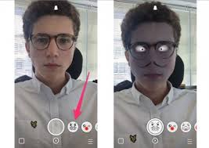
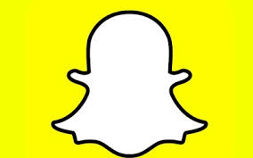
USED THIS?

Slide 2
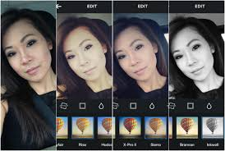
USED THIS ? (Don’t Lie :P)

Slide 3

The one that does all these cool features

Slide 4
Classical Definition
Image processing is a method to convert an image into digital form and perform some operations on it, in order to get an enhanced image or to extract some useful information from it. It is a type of signal dispensation in which input is image, like video frame or photograph and output may be image or characteristics associated with that image.

Slide 5
OpenCV
OpenCV is a library of programming functions mainly aimed at real-time computer vision. Originally developed by Intel, it was later supported by Willow Garage then Itseez. The library is cross-platform and free for use under the open-source BSD license

Slide 6
Basic functions In OpenCV
Import cv2 //importing OpenCV
cv2.imread(“directory/imagename”)
- Reads the image from specified path
cv2.imshow(“windowname”, <imagevariable>)
- Displays the image to specified window
cv2.imwrite(“directory/name”, <imagevariable>)
- Saves image to specified path

Slide 7
Basic functions in OpenCV
cv2.waitKey( )
- function waits for specifies miliseconds for any keyboard event. If “0” is passed, it waits indefinitely for a key stroke.
cv2.destroAllWindows()
- simply destroys all the windows we created
cv2.VideoCapture()
- to capture a video, you need to create a VideoCaptureobject

Slide 8
Drawing functions
img = np.zeros((512,512,3), np.uint8)
# Draw Line
img = cv2.line(img,(0,0),(511,511),(255,0,0),5)
# Draw Reactangle
img = cv2.rectangle(img,(384,0),(510,128),(0,255,0),3)
# Draw Circle
img = cv2.circle(img,(447,63), 63, (0,0,255), -1)
# Put text
cv2.putText(img,'OpenCV',(10,500), font, 4,(255,255,255),2,cv2.LINE_AA)

Slide 9
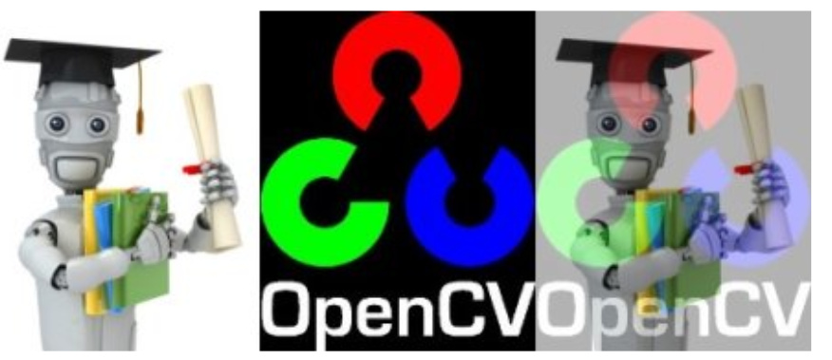
Arithmetic operations on images
# Image Addition:
output = img1 + img2
# Image Subtraction:
sub = img1 – img2
# Image Blending:
cv2.addWeighted(img1, 0.7, img2, 0.3, 0)

Slide 10
Gray Scale
Grayscale maps intensity of each pixel from black to white.
It carries only intensity information and not color information.
Thus 8-bit grayscale has values from 0-255
0 corresponds to black.
255 corresponds to white.
Grayscale is generally used when colour information is not needed and where processing should be faster because we use only one channel now rather than 3 channels.

Slide 11
Color-space Conversion
import cv2
img = cv2.imread(“spider.jpg”)
#Converting from BGR to grayscale
gray = cv2.cvtColor(img, cv2.COLOR_BGR2GRAY)
#Converting from grayscale to BGR
bgr = cv2.cvtColor(gray, cv2.COLOR_GRAY2BGR)
#Converting from BGR to HSV
hsv = cv2.cvtColor(img, cv2.COLOR_BGR2HSV)

